Slide 1
Dynatrace Basic Training
Objective: Application Health, View and Interpret Metric/Chart Detail, & Verify Alerts
<Presenter>, <Date>

Slide 2
Agenda
Application Health
Monitoring Overview
Application Overview
AvgRT/Overview Dashboards
Host Health
Host Health Overview Dashboards
Process Health Dashboards
Verification of Alerts
Where do I find more information on Dynatrace?
Exercises for comprehension of material

Slide 3
What is a healthy application?
An application that can perform the functions required for the services it supports

Slide 4
KPIs of App Health
End User Experience
Response Time
Failure Rate
Availability

Slide 5
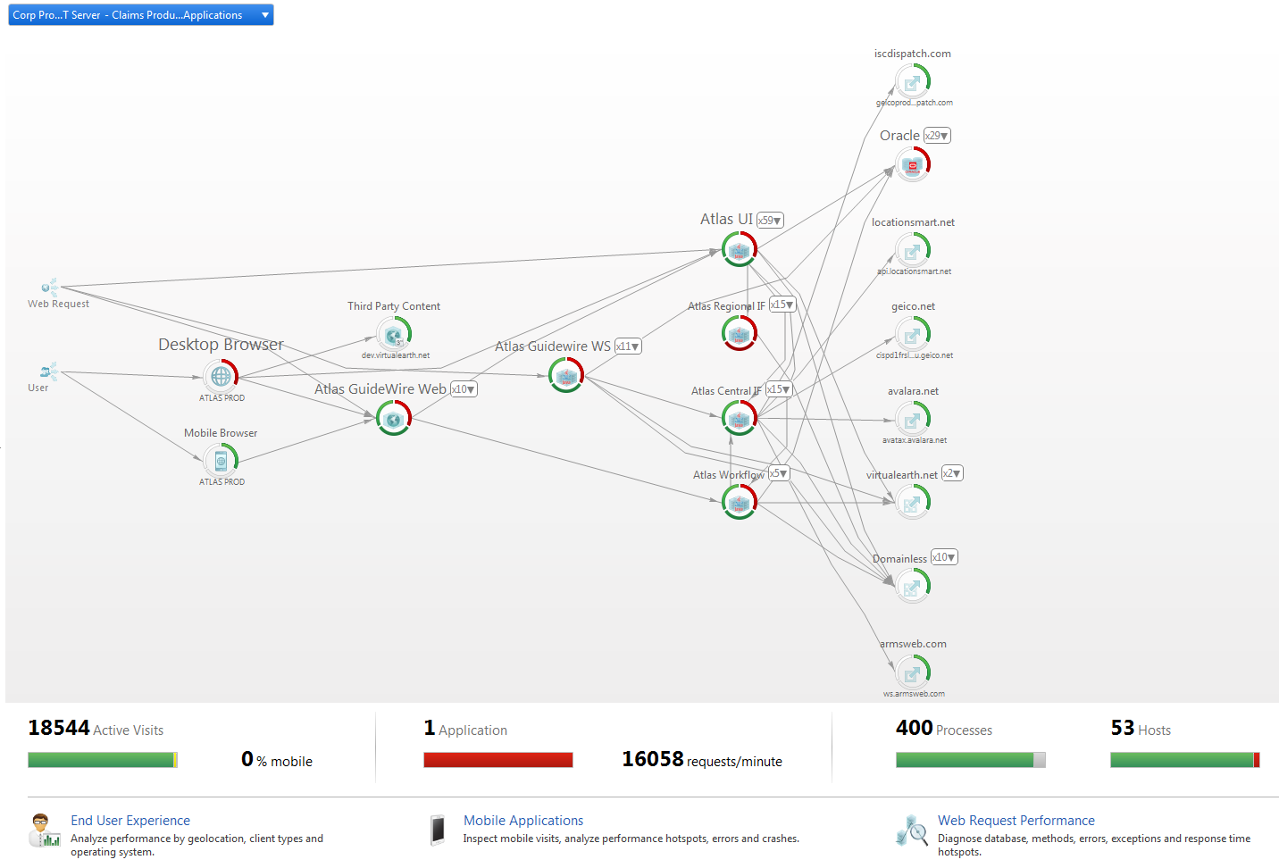
Monitoring Overview
Notes:
The Monitoring Overview embeds a Transaction Flow Dashlet (a piece of a dashboard) to show an overview of your environment featuring OMNI-channel (the main entry points grouped by channel (client types) and application), Agent Groups, databases, and external services.
Note: The Transaction Flow embedded in the Monitoring Overview Dashboard is optimized for quick data access and for app monitoring across an entire system profile.
For viewing only your application, advanced analysis and to access all drill down options, use the Transaction Flow Dashlet in your application’s General Dashboard

Slide 6
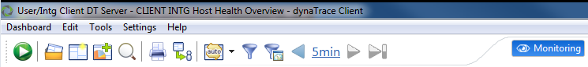
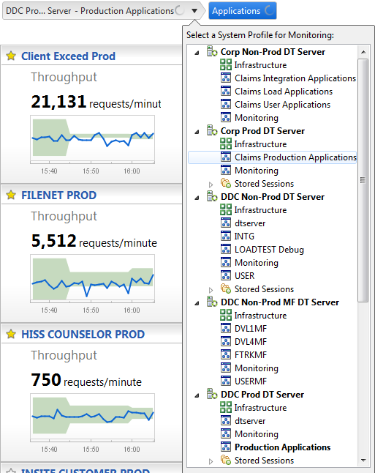
Monitoring Overview - Opening
Notes:
Click Blue monitoring Button then select the appropriate system profile
Explain DT Servers and System Profiles

Slide 7
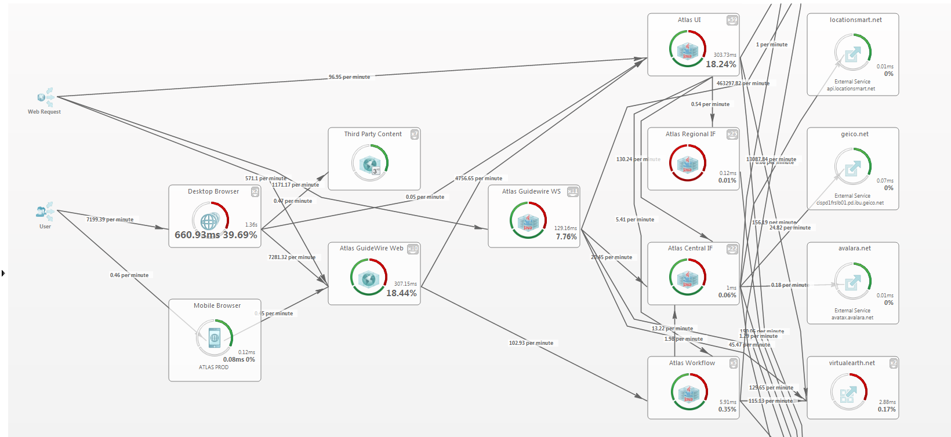
Monitoring Overview – Transaction Flow
Notes:
Zooming in we see start to see more detailed information
This diagram is organized my Agent Groups (logical portions or tiers of an application).
The percentage is the response time contribution of that tier for all requests in the specified timeline
The x per minute is the number of transactions going to those tiers
Note the Third Party Content
We see user actions as we have UEM enabled on this application, web requests from other services
Note The backend services or Databases on the right

Slide 8
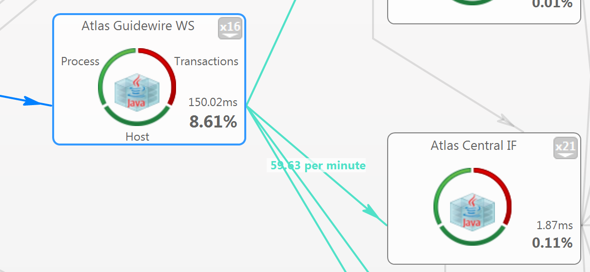
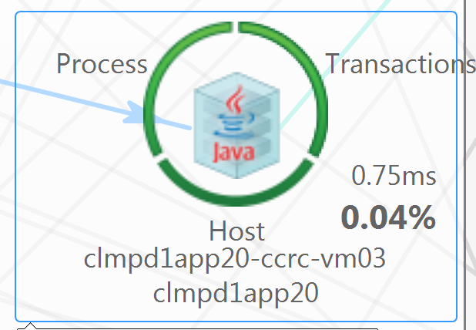
Transaction Flow - Component Legend
Notes:
The circles around the agent (process or JVM), shows the health of the Processes, Host, or passing Transactions.
The Process and host metrics thresholds are aggregated from the same criteria as the Host Health Overview (Covered Later in Presentation).
(Mostly DT Defaults but we will be customizing as we migrated to <client name>/App Team Defaults)
The Transactional health is if there are any failed transactions or errors
Percent is the response time contribution of all transactions in flow in that time frame. Contribution can be at Agent group or jvm/process level.
Arrows in and out are throughput of requests.
Ms is average response time on that tier/agent group or jvm/process

Slide 9
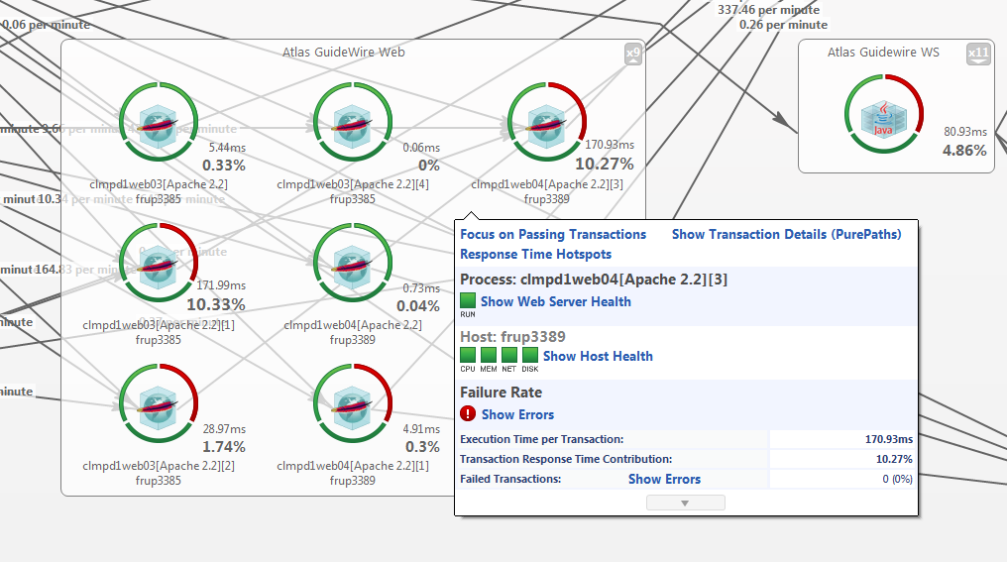
Hover Over Component
Notes:
Clicking on the agent groups gives visibility to the individual agents (processes or JVMs).
.

Slide 10
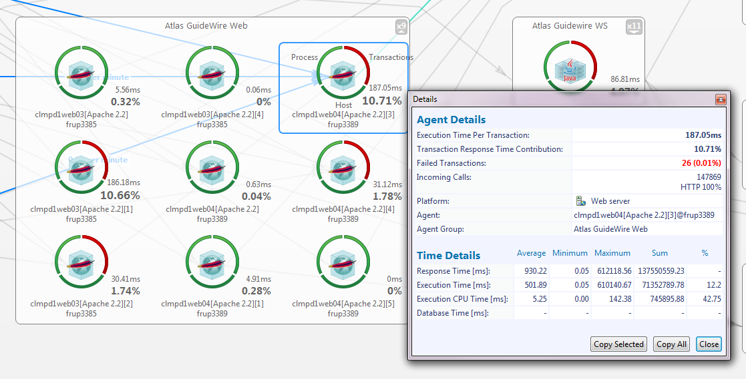
Right Click for Details
Notes:
Right Clicking gives more details

Slide 11
Exercise
Open the Dynatrace Client
Navigate to the Transaction Flow for 2 Different System Profiles
Analyze Application for Performance Bottlenecks
Notes:
Do a quick walkthrough of the exercise before asking others to do it
https://community.dynatrace.com/community/display/DOCDT62/Transaction+Flow

Slide 12
Questions on Transaction Flow?

Slide 13
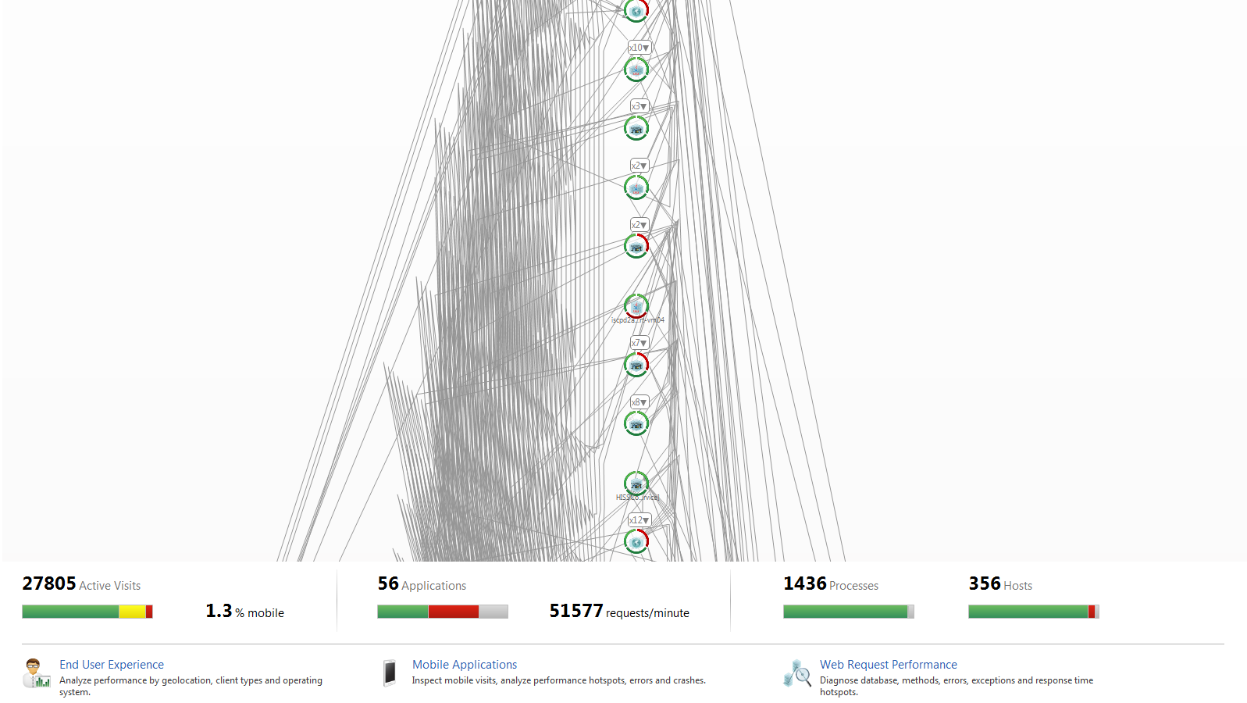
Monitoring Overview
Notes:
Back to the Monitoring Overview – We can go into the Application Overview
Explain here that this is the PROD Monitoring Overview. While it has tons of apps, it is hard to use. When we migrate, you will only see the apps per DT Server.

Slide 14
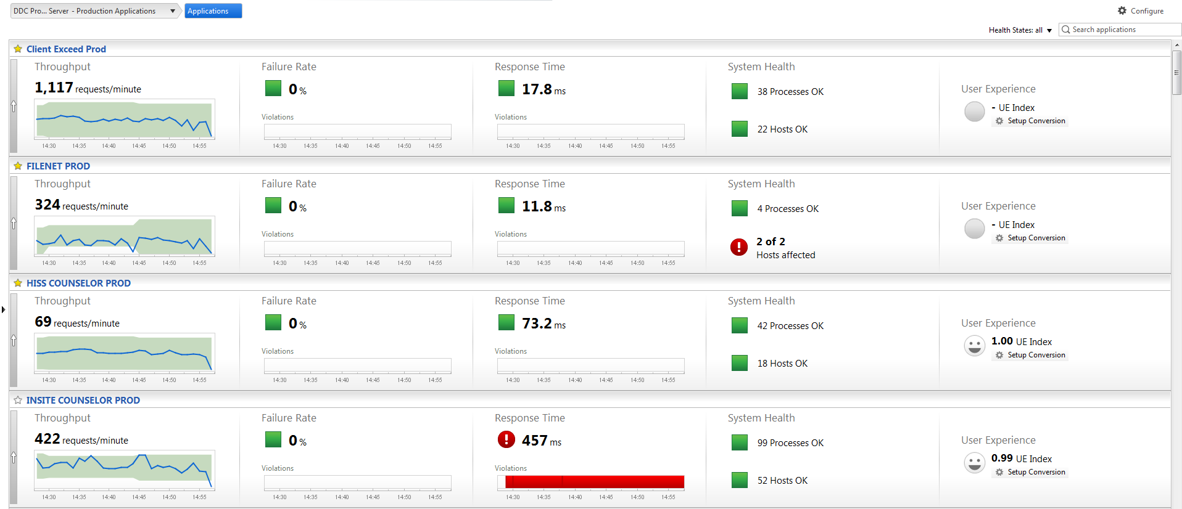
App Overview – Click on Applications
Notes:
Filter on App Health
Favorite by Star - the apps are sorted by relevance (star then violatons)
https://community.dynatrace.com/community/display/DOCDT62/Application+Overview+Dashboard
Explain all portions – Through put, failure rate, response time – median , system health, and UEM (explain that UEM will be covered in full detail in the next presentation)
Mention Dynamic baselines but cover them more in detail in 2 slides

Slide 15
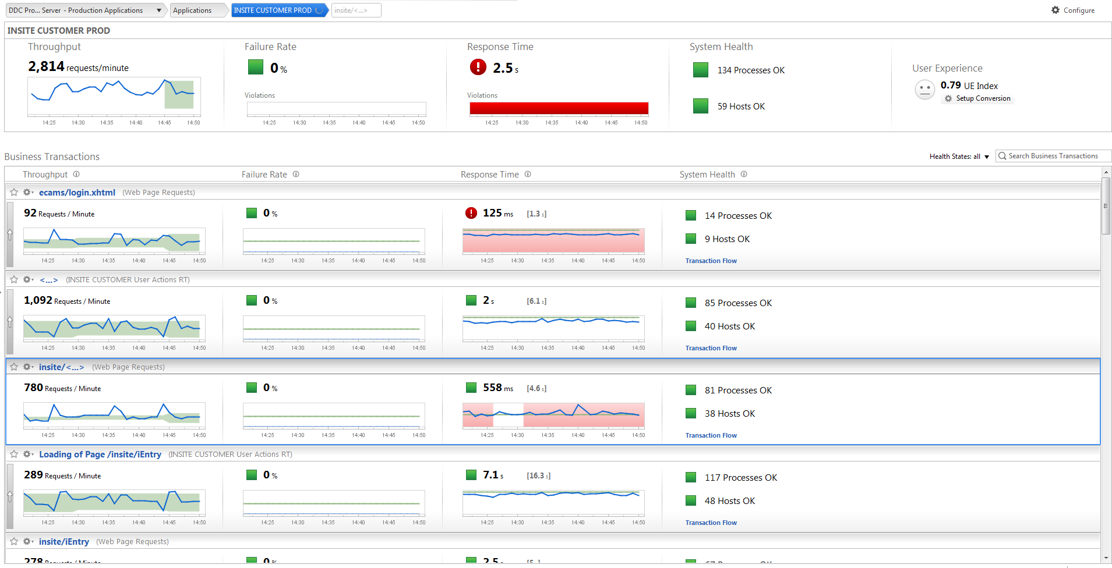
App Overview – Click on an App
Notes:
Filter on App Health
Favorite by Star - the apps are sorted by relevance
https://community.dynatrace.com/community/display/DOCDT62/Application+Overview+Dashboard
Explain all portions – Through put, failure rate, response time – median , system health, and UEM
Mention Dynamic baselines but cover them more in detail in 2 slides

Slide 16
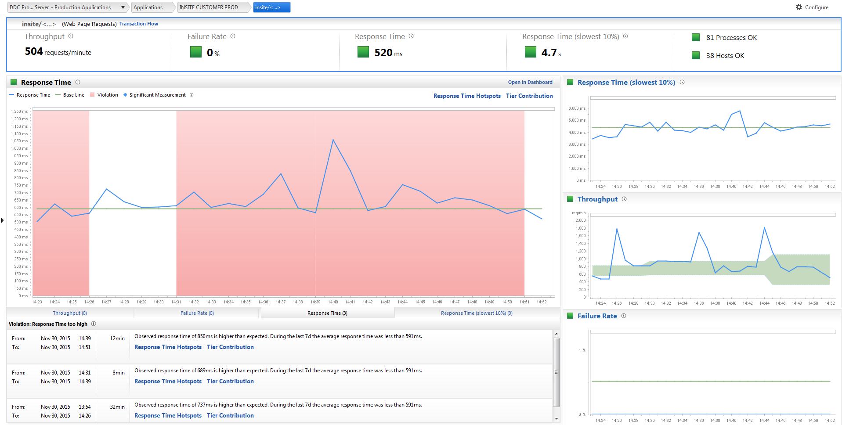
App Overview – Click on a Transaction
Notes:
https://community.dynatrace.com/community/display/DOCDT61/Baseline+and+Smart+Alerting+Explained
As the baseline is calculated every day using the data of the past 7 days, it automatically adapts to changes in your application.
Violations begin when 2 or more significant measurements violate the baseline, a violation ends when at least one of the violating measurements falls below the baseline.
A measurement is significant if there is enough throughput to accurately determine if it is above or below the baseline
These come in as incidents and are forwarded to BPPM for all apps, We are not currently paging but would like to
Transactional Information like web requests and user actions can be dynamically baselined (Business Transactions). Metrics like host health and process health need hard set baselines.

Slide 17
Exercise
Navigate to Application Overview
Can you find any transactions with violations?
Notes:
Do a quick walkthrough of the exercise before asking others to do it
https://community.dynatrace.com/community/display/DOCDT62/Transaction+Flow

Slide 18
Questions on Application Overview?

Slide 19
Custom Dashboards
While the Dynatrace Default Dashboards are
very powerful, sometimes you want to view the
specifics of your application

Slide 20
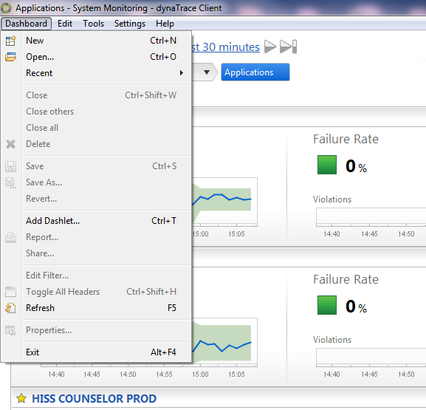
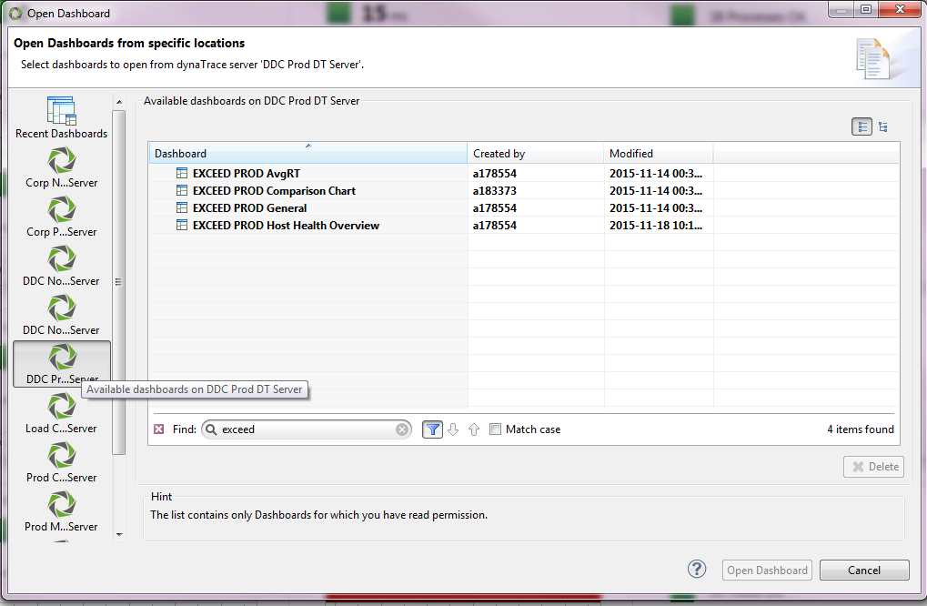
Custom Dashboards – How to Access?
Notes:
Explain how to see which DT server it is on
Explain how to filter – click and type

Slide 21
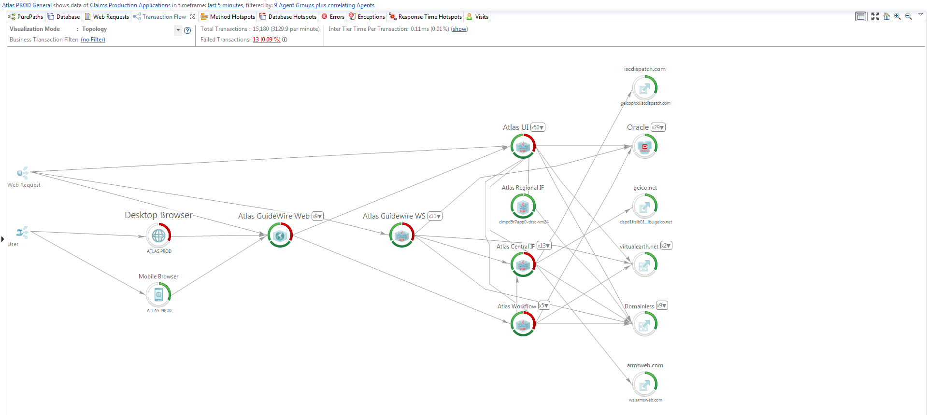
General Dashboard
Notes:
Only show transaction flow
Easy way to see transaction flow for a specific app
Other dashlets will be explained in further training
Explain the time period vs amount of data to load

Slide 22
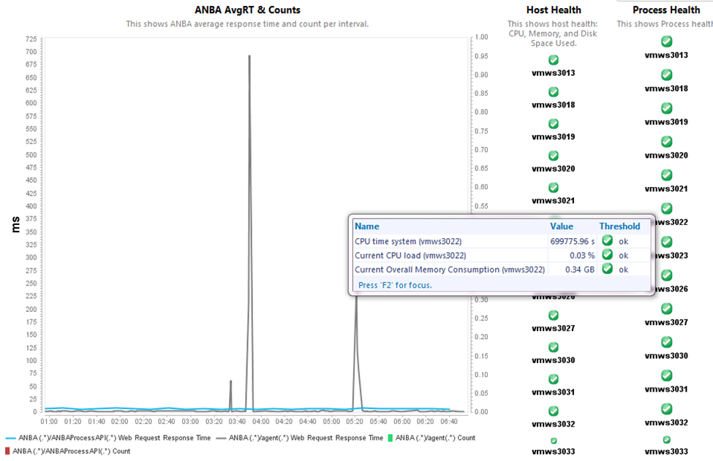
AvgRT/Overview Dashboards
Notes:
Example Avgrt dashboard every app gets
This is our basic Overview of application health, but many apps have customized dashboards
Hover over individual portions of charts to see metrics
This is a great place to mention hard set thresholds
Explain dual axis charting here

Slide 23
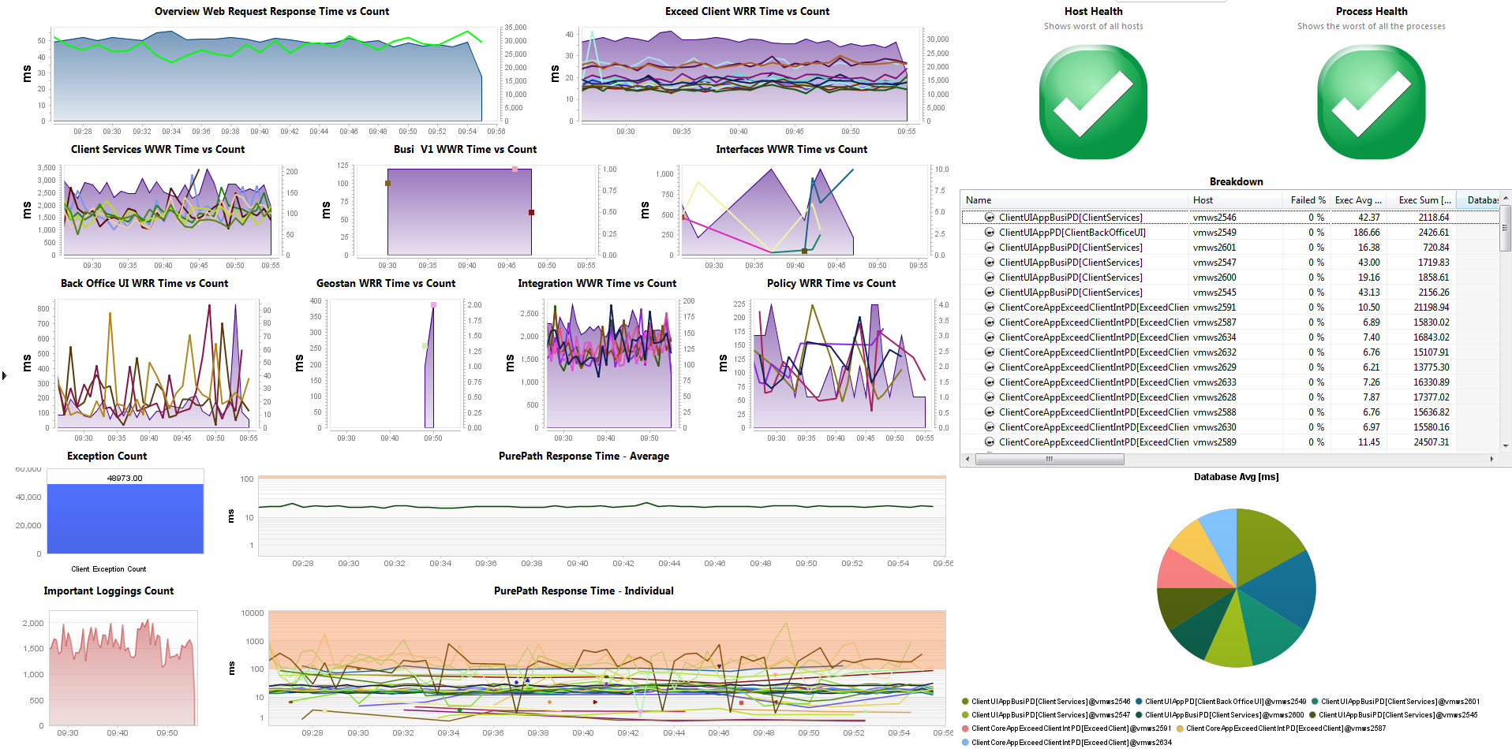
Custom AvgRT/Overview Dashboards

Slide 24
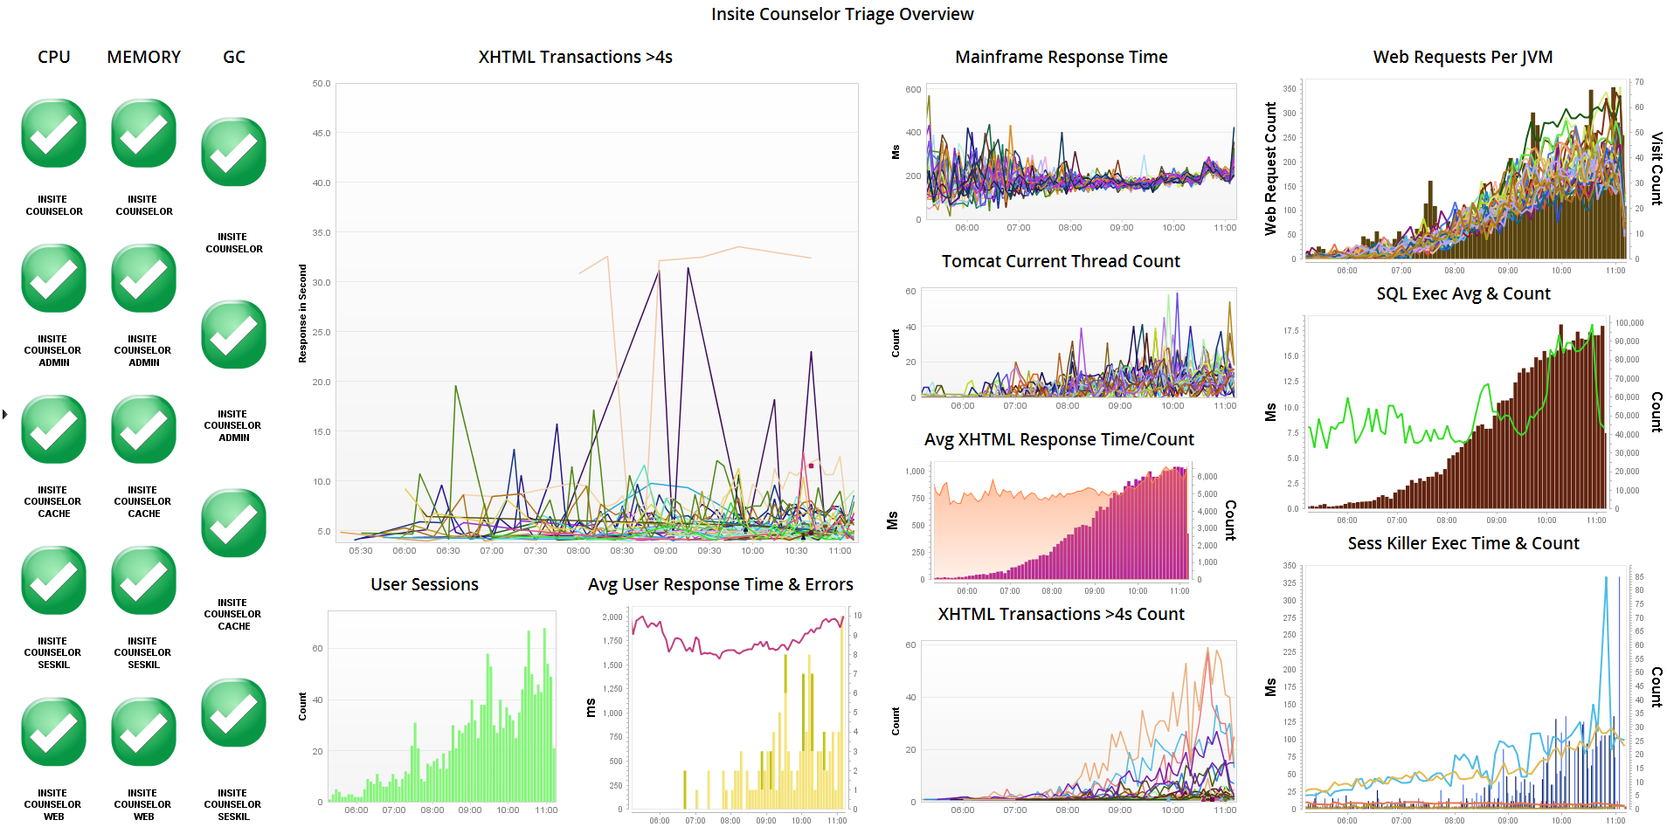
Custom AvgRT/Overview Dashboards

Slide 25
Questions on AvgRT/Overview Dashboards?

Slide 26
Host Health

Slide 27
Monitoring Overview
Notes:
How to get to host health from here

Slide 28
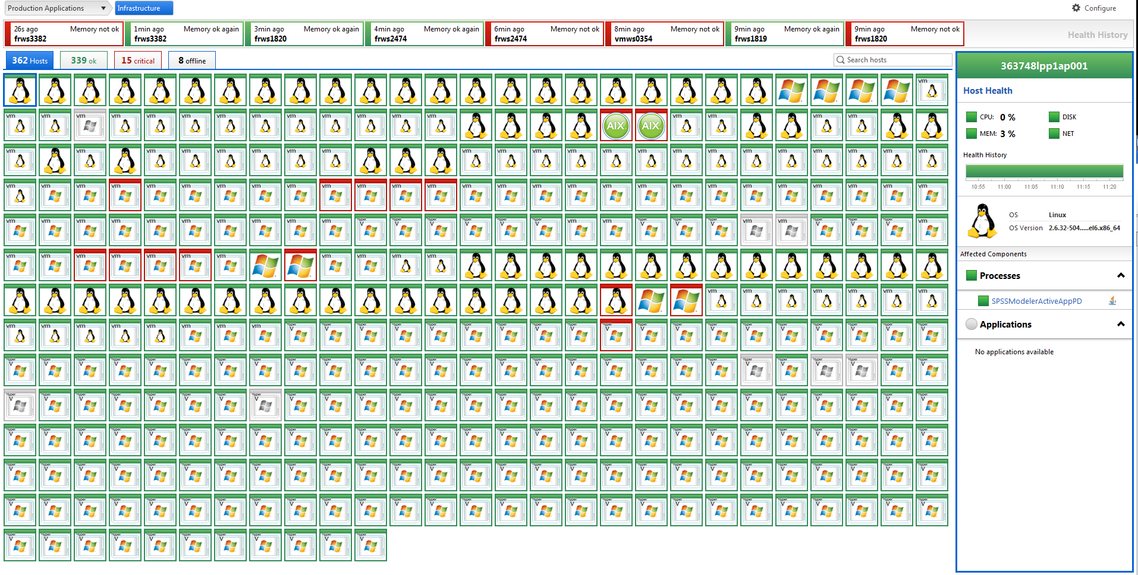
Host Health – Click on Processes/Hosts
Notes:
Explain how this is for all hosts we are monitoring in that system profile
To make it easier for app teams, we use host health overviews

Slide 29
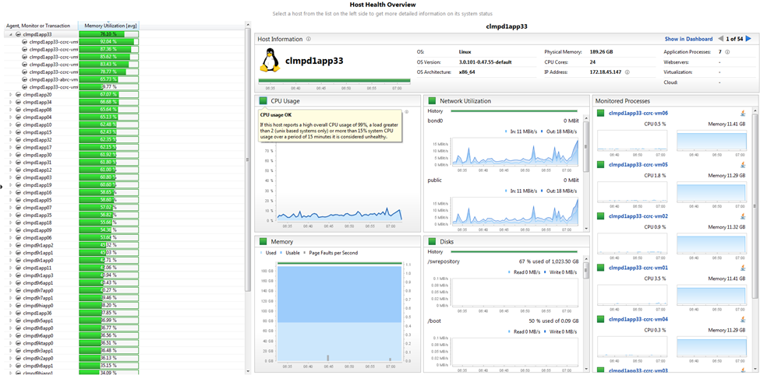
Host Health Overview Custom Dashboard
Notes:
Explain that this is viewed from the same way we saw all the other custom dashboards
Explain hover over for metrics
Go through the metrics in a live demo
Explain clicking makes the other chart change to the host you want
Explain process
Explain that the squares are the same as the host health metrics in the transaction flow. While we started with DT Defaults, we are going to be going to <client name>/App Thresholds as we migrate to provide more accurate views of the applications

Slide 30
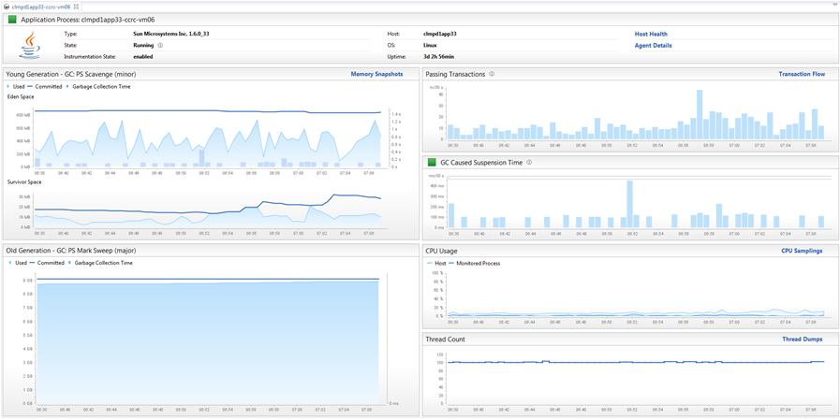
Process Health – Click on Process

Slide 31
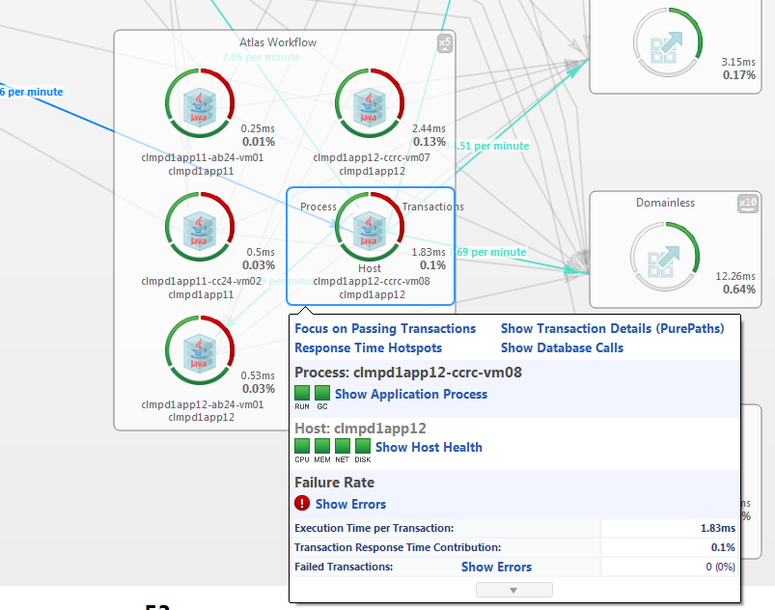
Monitoring Overview – Host Health Revisited
Notes:
Remember how we got here from the Monitoring Overview?
Explain the same red/green in host health is showing in the transaction flow
You can get to process or host health from here too

Slide 32
Exercise
Find a Host or Process that is red
Why is it red?
Did you get there from the Monitoring/Application
overview or from Host Health Overview?
Try to find the same problem from the other way
Notes:
Do a quick walkthrough of the exercise before asking others to do it

Slide 33
Questions?

Slide 34
Verification of Alerts

Slide 35
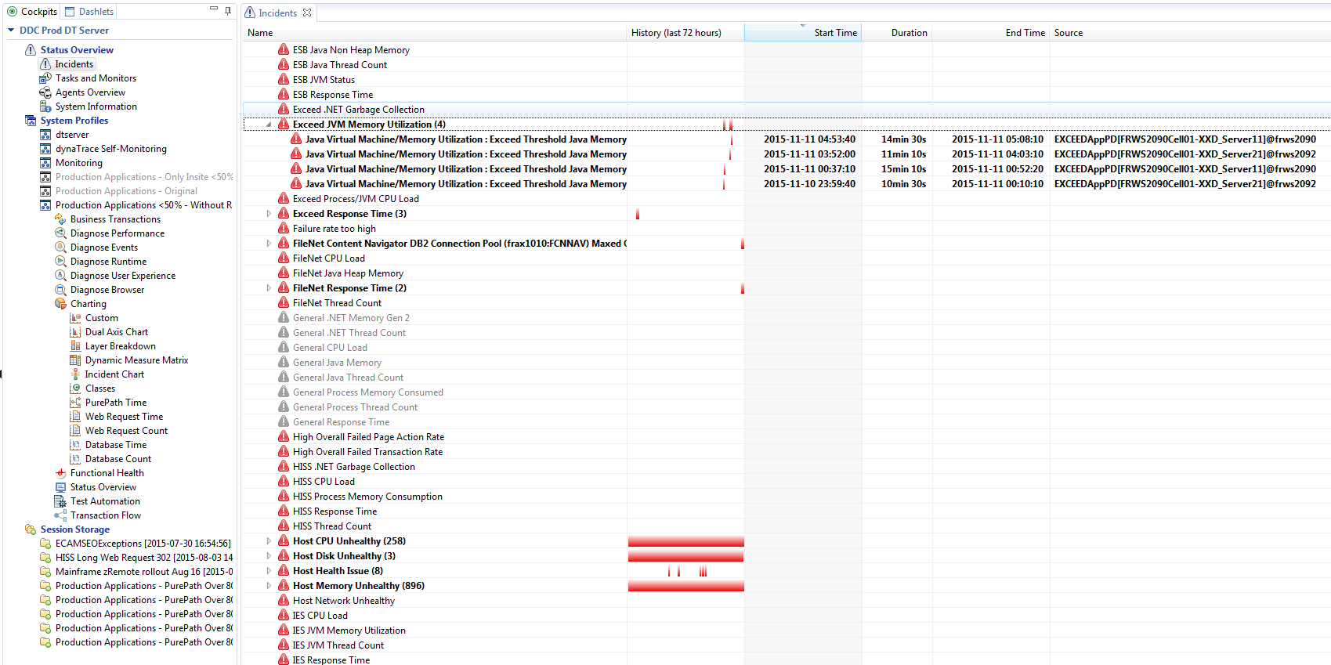
Incidents
Notes:
All alerts that come from BPPM are generated from incidents, however, not all incidents are sent to BPPM or alerted on
(some are default DT incidents or violations)

Slide 36
Where do I go to verify alerts?
Which application is it?
Shows which DT environment and dashboard to open
Is the alert for CPU, Memory, or Disk?
Host and Process Metrics can be found in the Host Health Overview Dashboard for that application
Is the alert for Response Time or Failure Rate?
These metrics are all visible in the Application Overview Dashboard
All other metrics are available in an AvgRT, Overview, or Custom Dashboard per application.
Notes:
For verifying alerts, seeing trending data etc.

Slide 37
Exercise
Open the Incidents dashboard and find a recent incident
Verify the incident in another dashboard that will show trending data
Utilize steps from the last slide
Notes:
Do a quick walkthrough of the exercise before asking others to do it

Slide 38
Alerting/Incident Questions?

Slide 39
Recap
Application Health
Monitoring Overview
Application Overview
AvgRT/Overview Dashboards
Host Health
Host Health Overview Dashboards
Process Health Dashboards
Verification of Alerts
Where do I find more information on Dynatrace?
Training Reference Materials are available

Slide 40
Final Questions?

Slide 41
Where do I find more info on <Tool Name>?
Insert email, links to client documentation, etc.

Slide 42
Performance management for the digital customer age

